Slide 1
DESIGN THINKING WORKSHOP –(LUMA)
Online vs Offline Retailers(Price Comparator)

Slide 2
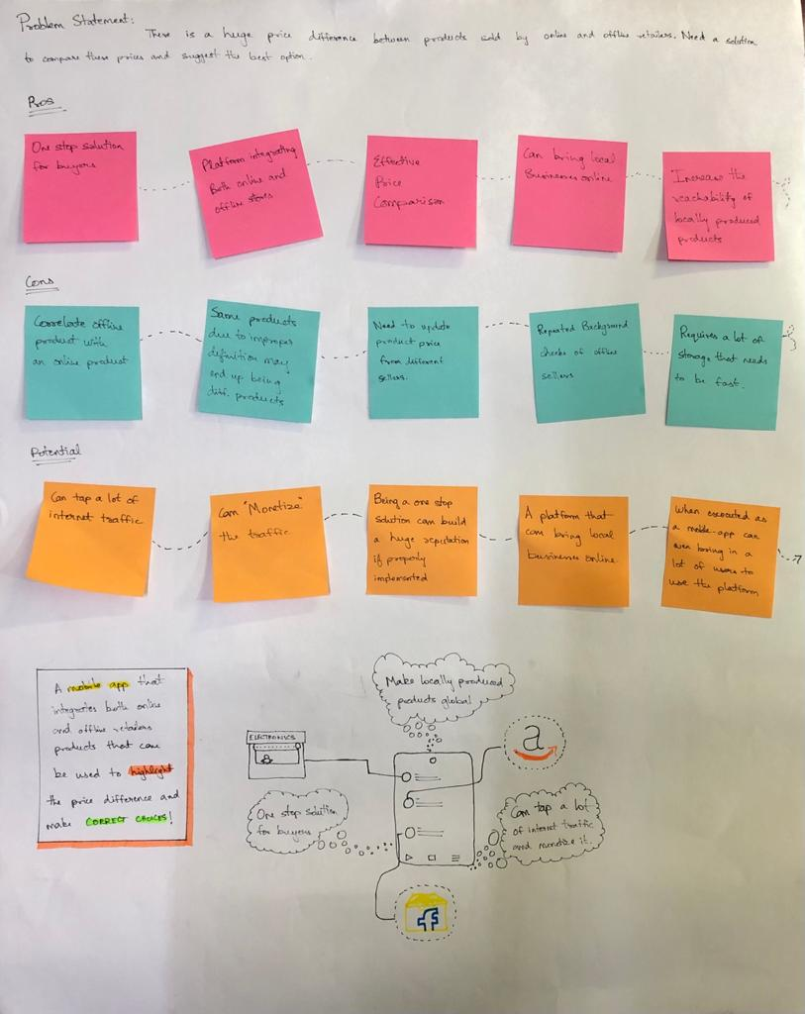
Dinesh A - 2010348

Slide 3
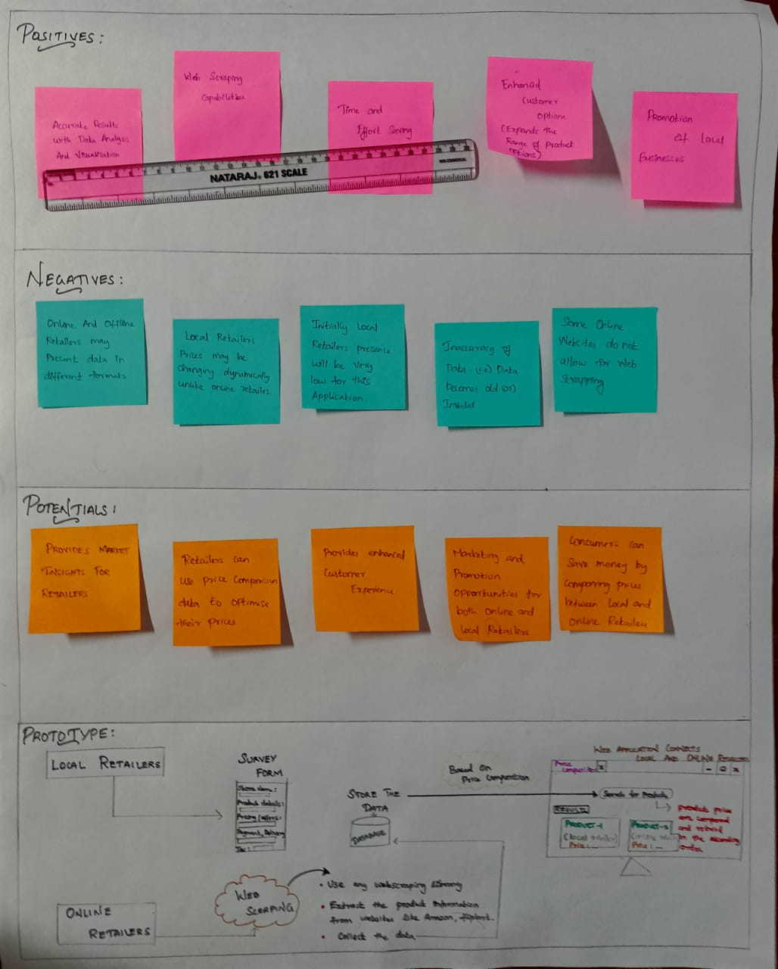
Mukesh K - 2010346

Slide 4
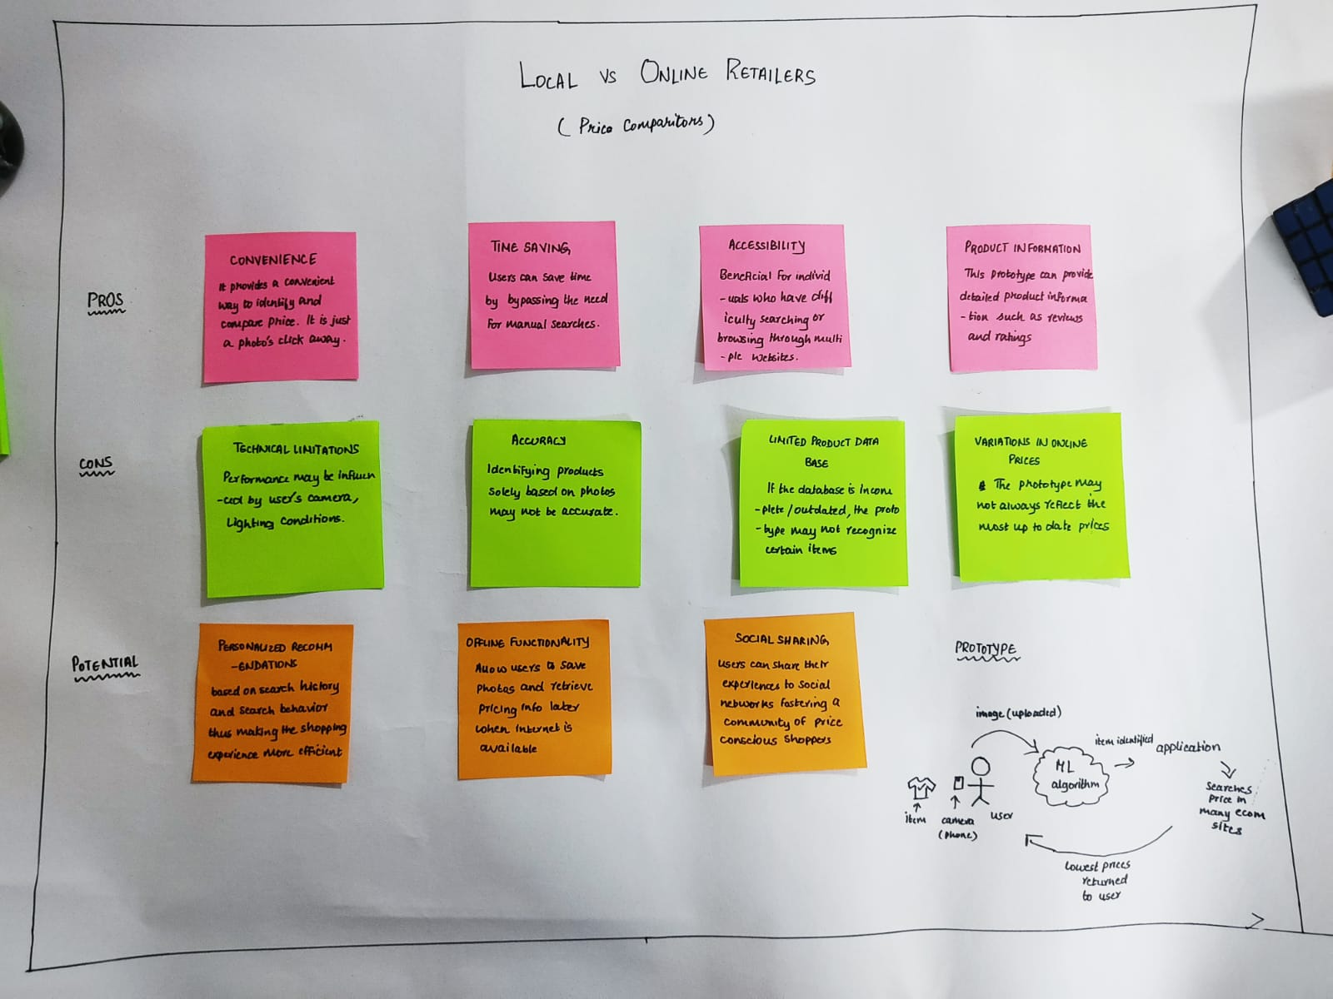
Rohan Sridhar - 2010093

Slide 5
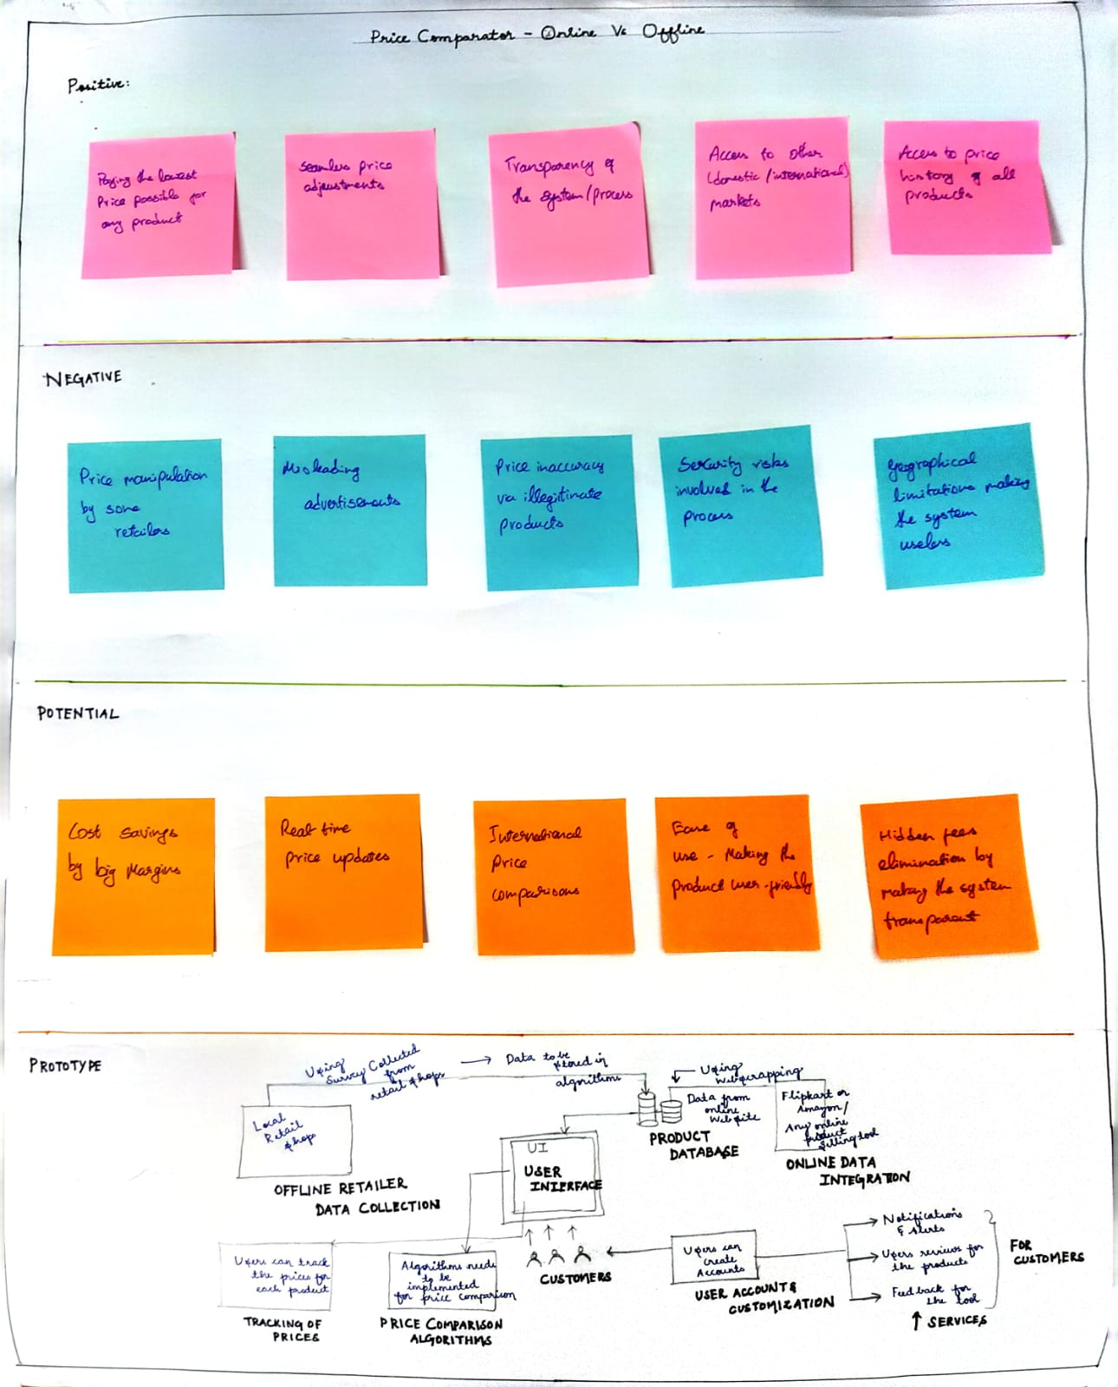
Santhosh Krishna - 2010133

Slide 6
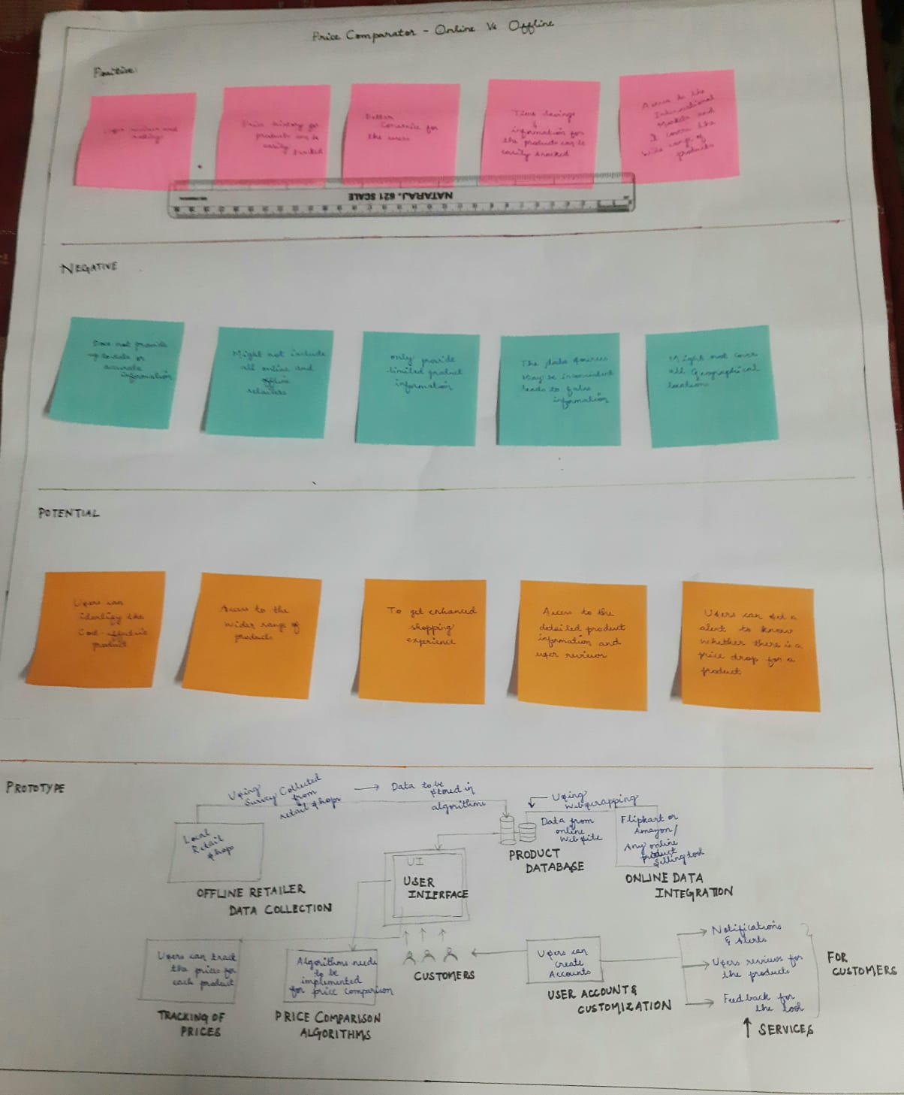
Sasikumar N - 2010239

Slide 7
Choosing Our Best Idea To Implement:

